Slide 1
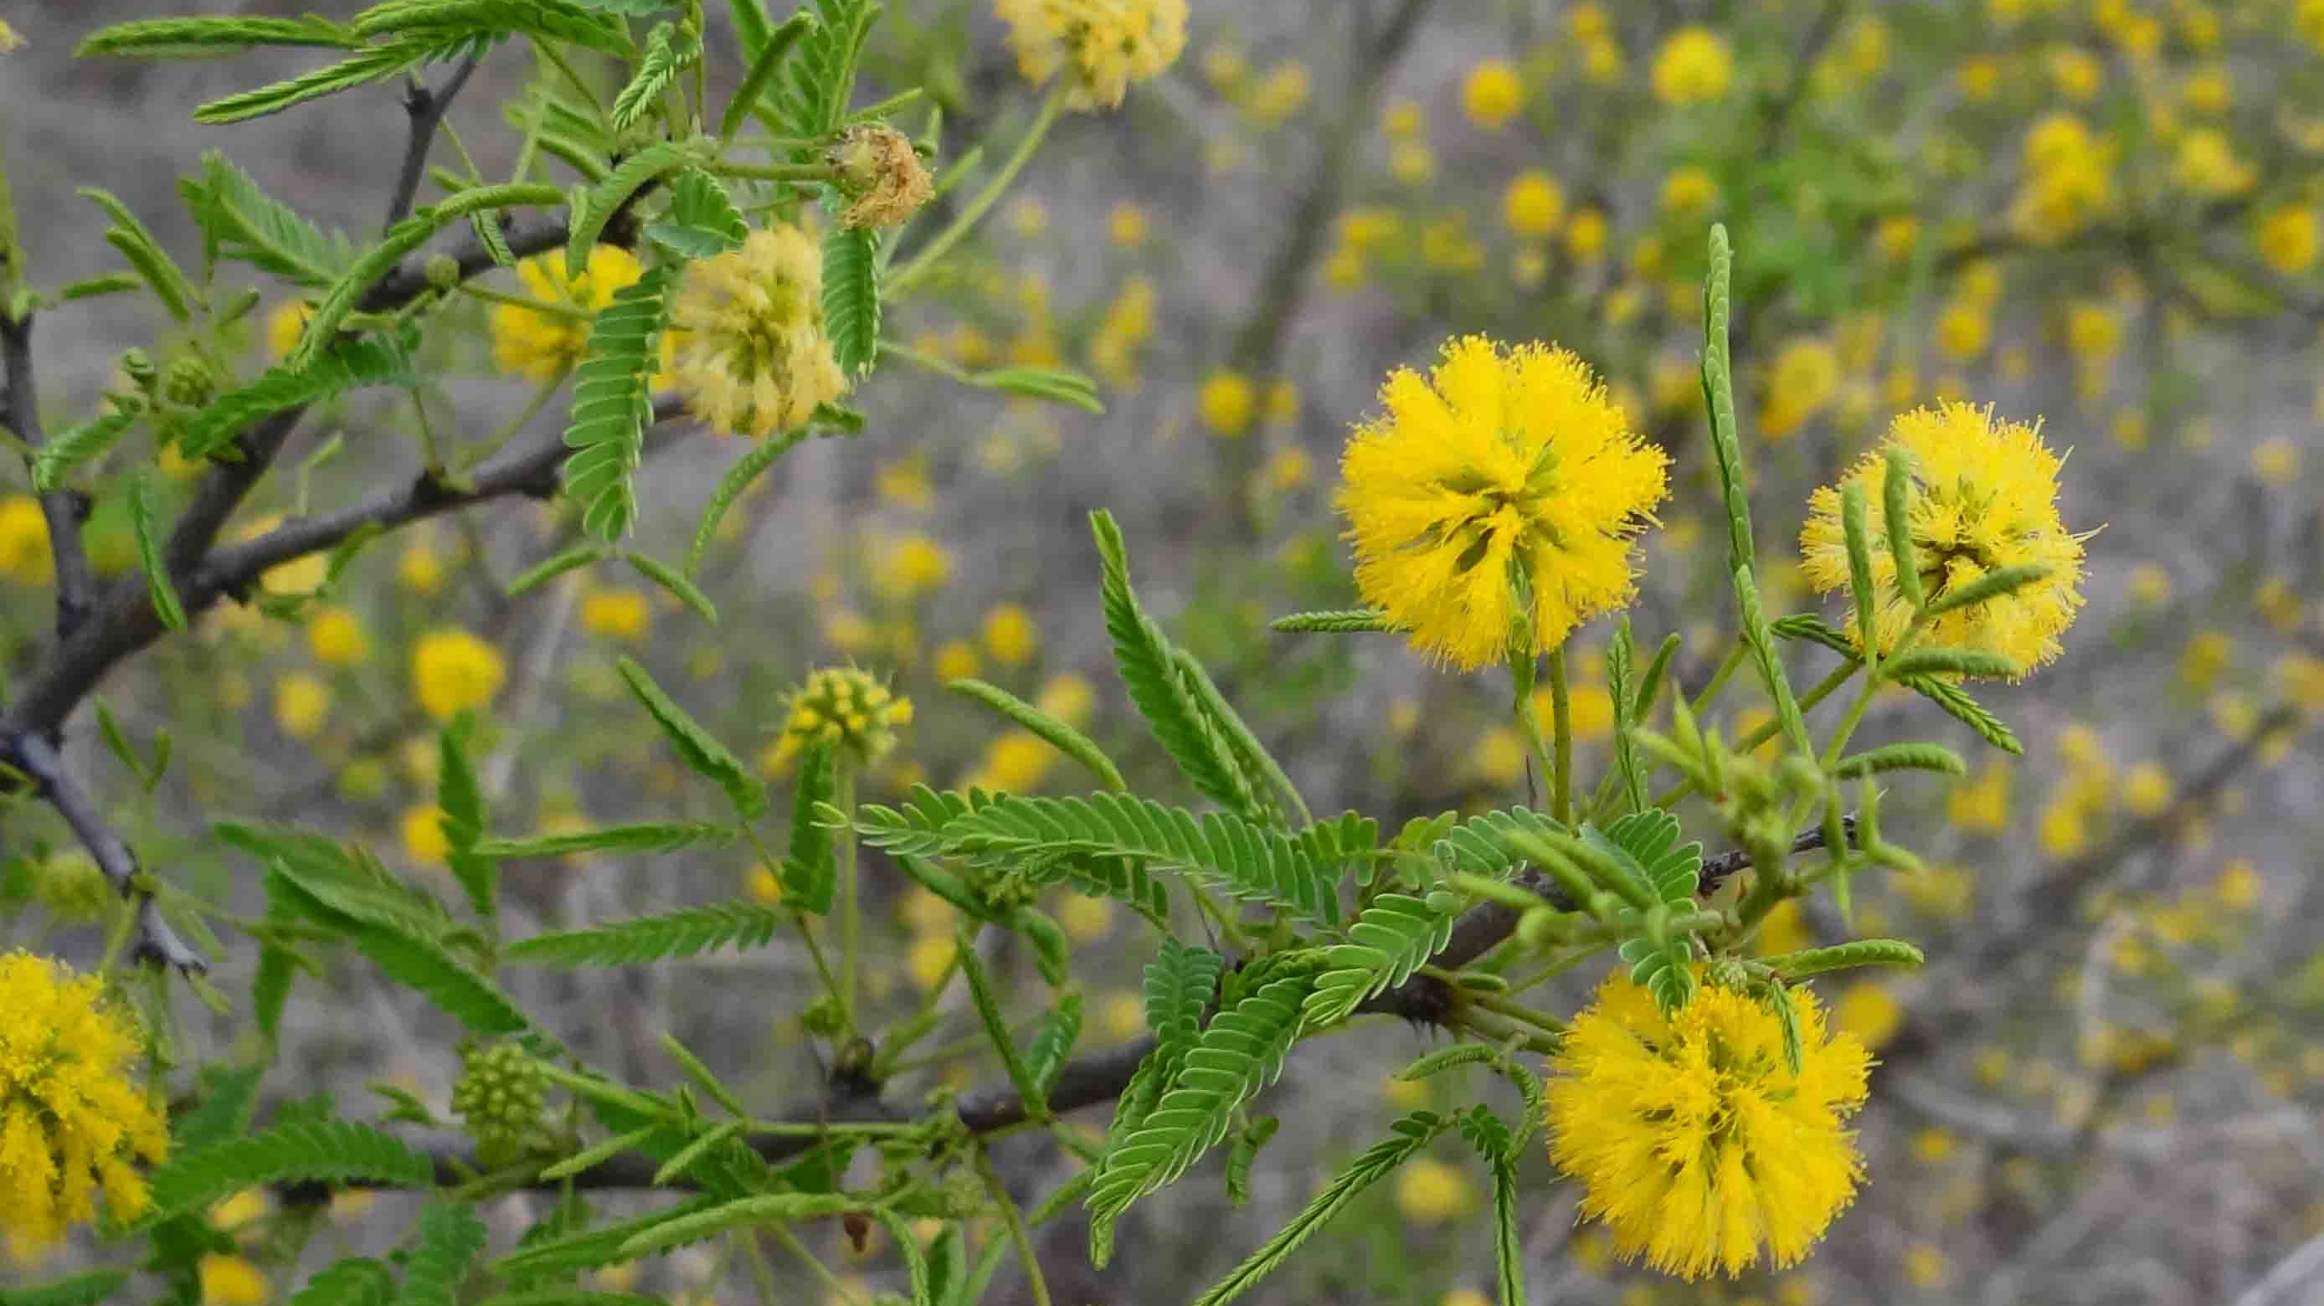


Exploring allelopathy of native woody species as potential approach for thorn forest restoration: A test on inhibition of germination.
Jennifer baez

Slide 2
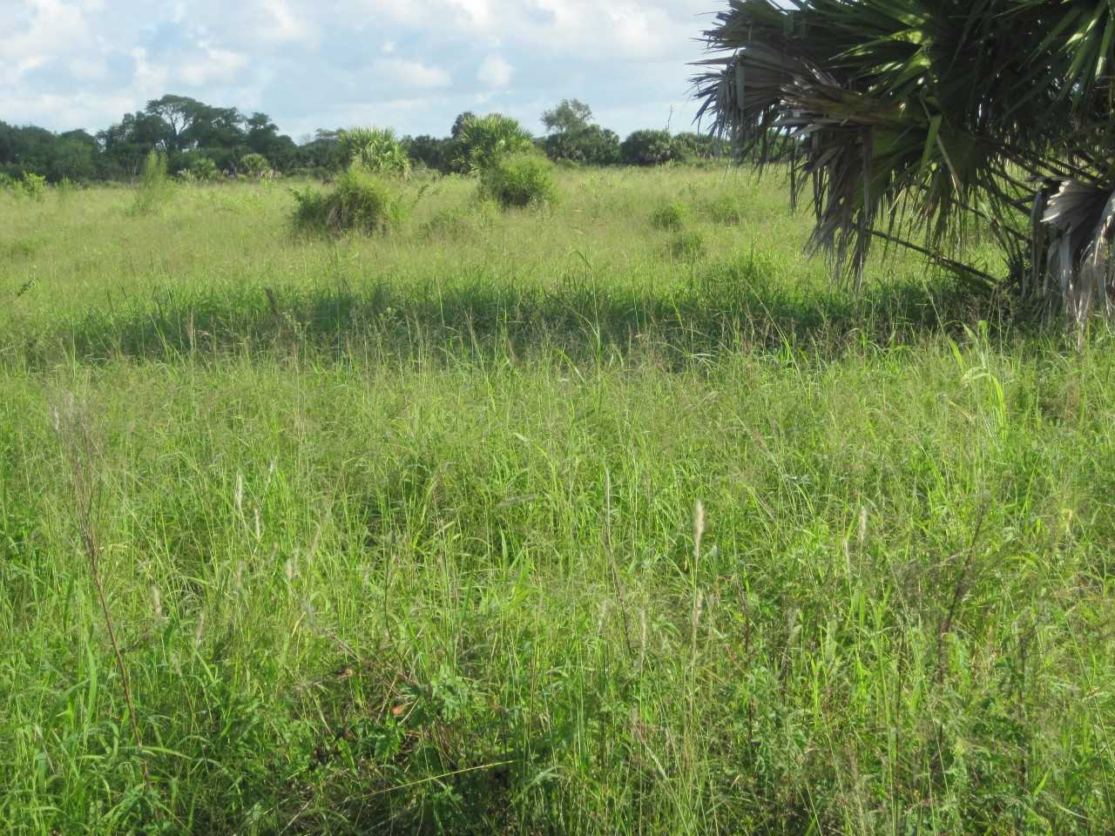
Introduction
A frequent impediment of restoration efforts are introduced species that become invasive.
In south Texas reforestation of abandoned fields using native seedlings is hindered by invasive grasses

Slide 3
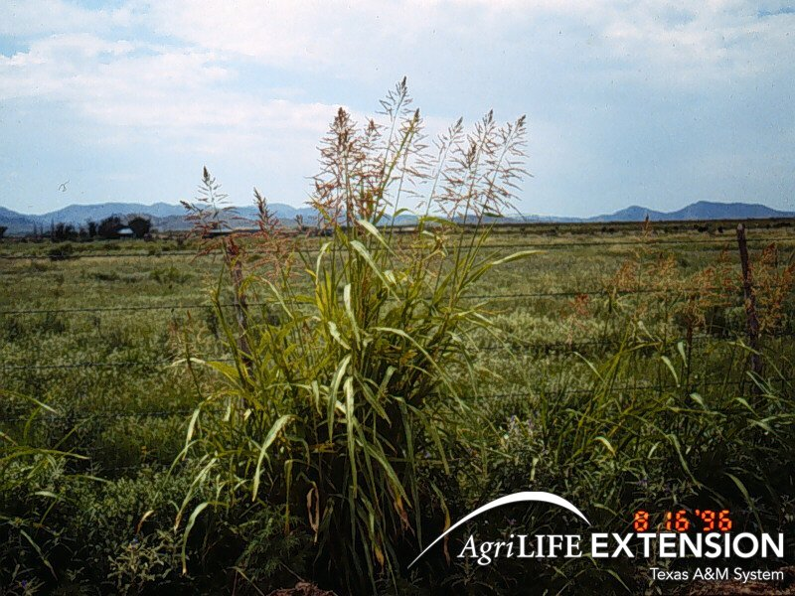
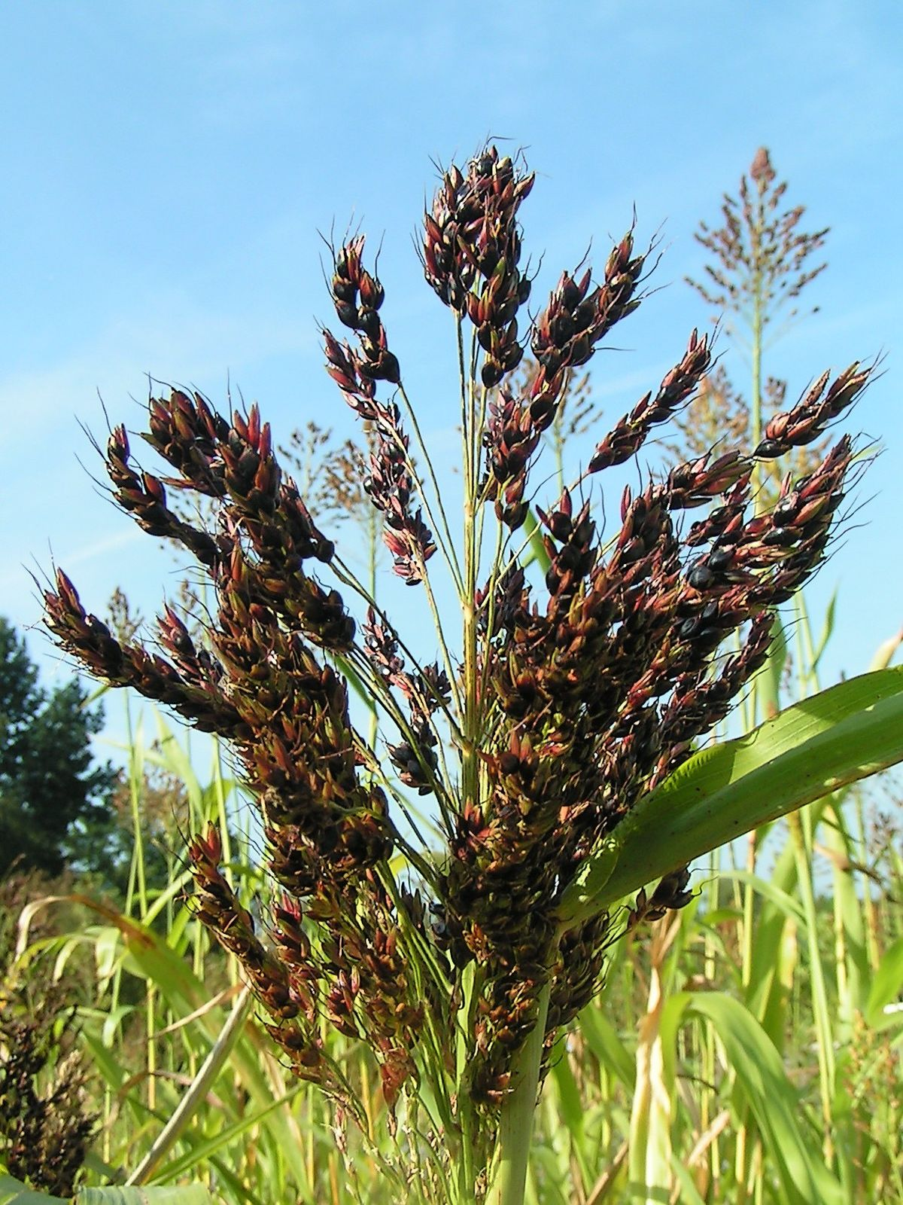
Introduction
Sorghum halepense (Johnson grass)
Sorghum Bi-color

Slide 4
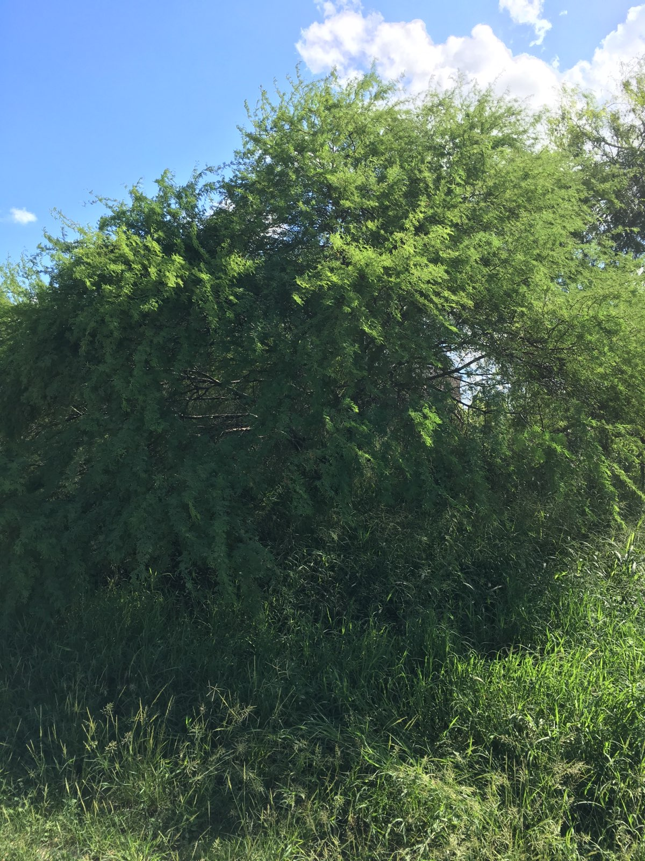
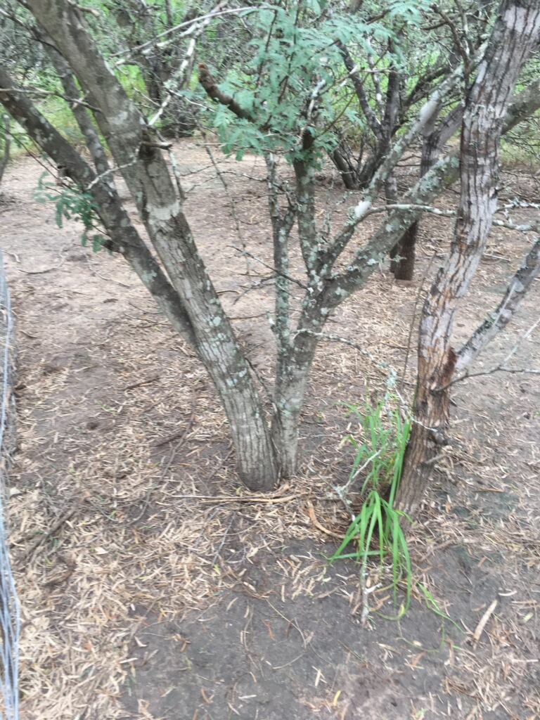
Introduction
To asses potential chemical inhibition of germination and seedling emergence by A. shaffneri, and compared it to a close but apparently non allelopathic species, A. farnesiana.
Acacia farnesania
Acacia. schaffneri

Slide 5
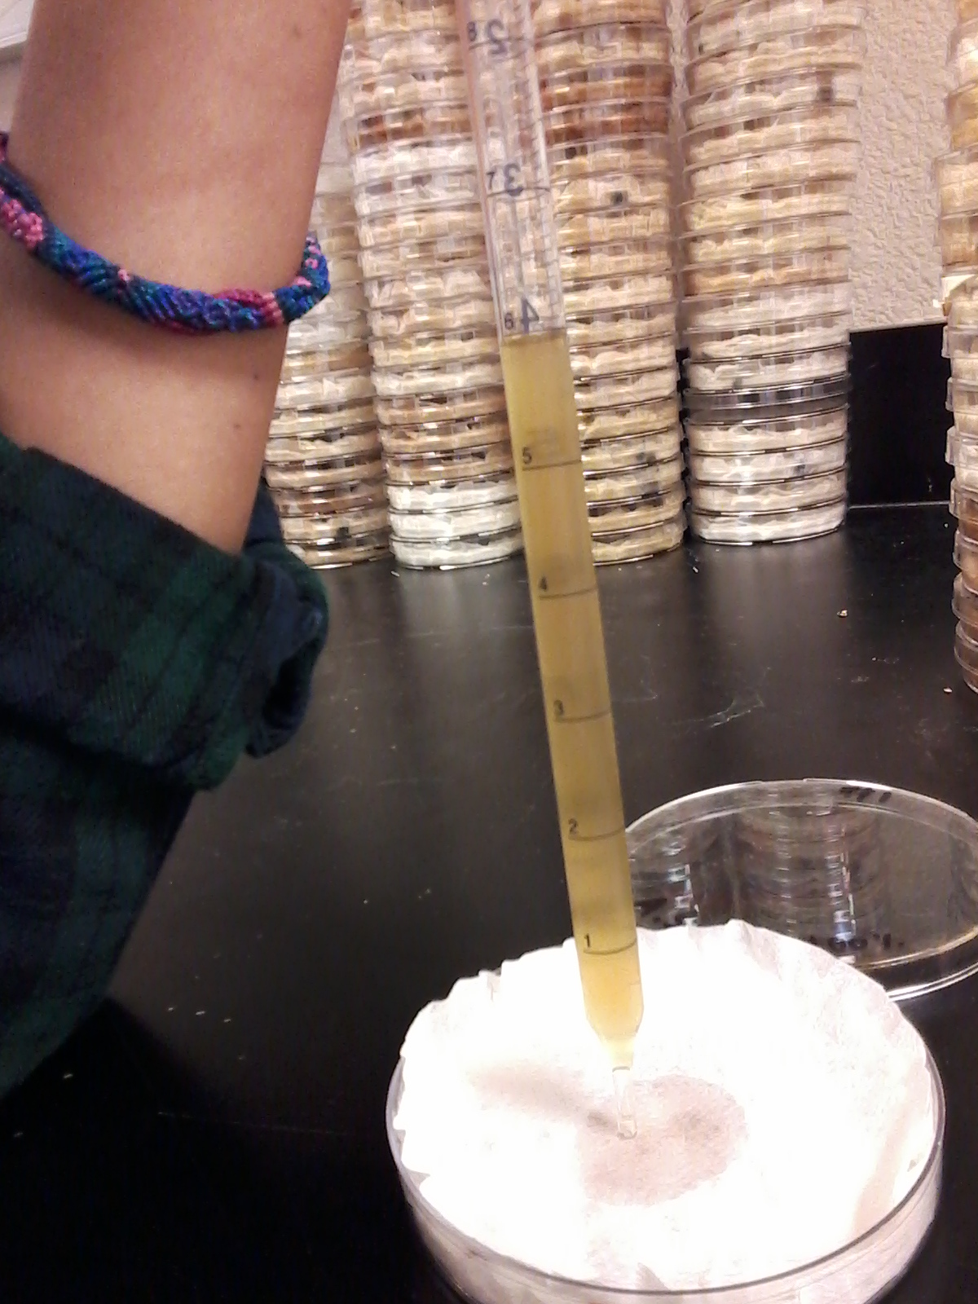
Germination Tests
100 seeds per dish (Sorghum bicolor)
Dishes lined with absorbent paper
6 ml of extract added to each dish
Germination at room temperature (24°C)
Germination was monitored each day
Germinated seed = radicle > 5 mm

Slide 6
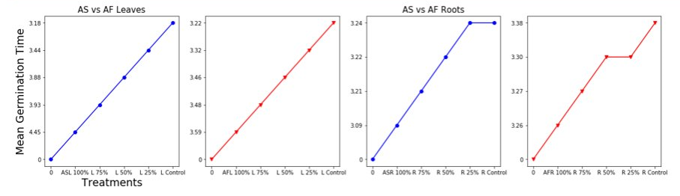
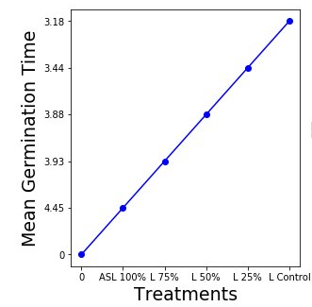

Slide 7
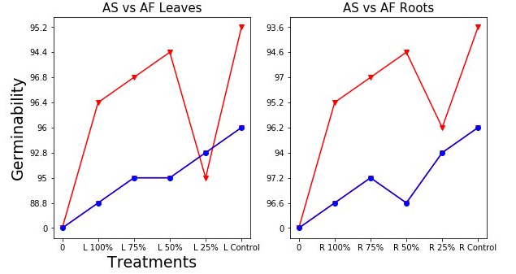
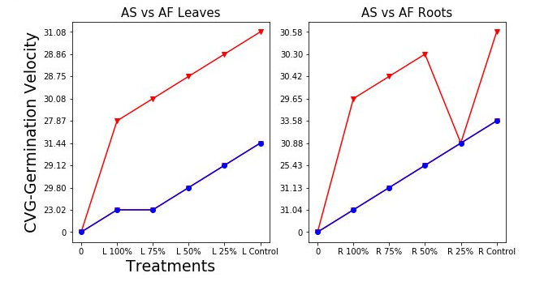

Slide 8
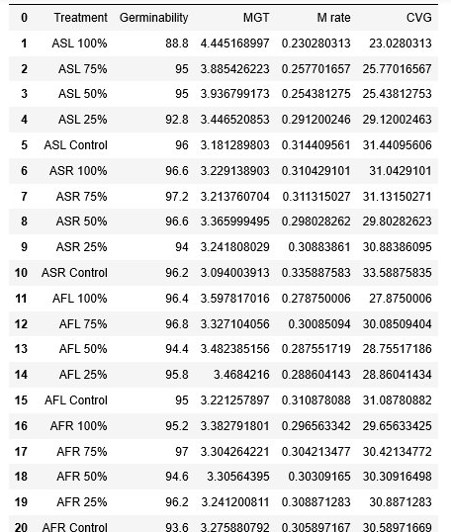
LEAVE TISSUE | Conc. (%) | Germ (%) | MGT (days) | CVG
A. shaffneri | 100 | 88.8 b | 4.45 a | 23.0 c
 | 75 | 95.0 a, b | 3.89 a, b, c | 25.8 b, c
 | 50 | 95.0 a, b | 3.94 a, b | 25.4 b, c
 | 25 | 92.8 a, b | 3.45 b, c, d | 29.1 a, b
 | 0 | 96.0 a, b | 3.18 d | 31.4 a
A. farnesiana | 100 | 96.4 a | 3.60 b, c, d | 27.9 a, b
 | 75 | 96.8 a | 3.33 c, d | 30.1 a
 | 50 | 94.4 a, b | 3.48 b, c, d | 28.8 a, b
 | 25 | 95.8 a, b | 3.47 b, c, d | 28.9 a, b
 | 0 | 95.0 a, b | 3.22 d | 31.1 a

Slide 9
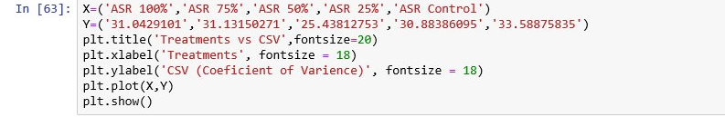
Conclusion
Leaf extract from A.shaffneri showed clear allelopathic effects affecting the germination process.
Factors playing an important role in the effect of allelochemicals include their concentration. Performing in field situations are critical to validating the significance of allelopathy observed in lab to restoration systems.
Histograms would show data best.

